Slide 1

Capstone Project – Exploring Greater Metropolitan Sydney
IBM – Data Science Professional Certificate

Slide 2
Introduction and problem
Being a first generation migrant myself, moving to new country brings a lot of challenges with it
The first dilemma we all face is where to live! To Rent or Buy, how many amenities nearby, how safe an area is, what is population and so on...
The best way to solve this riddle was to make use of data to understand the economic and social landscape of the area we are moving
Hence, using personal experience (and lot of Data of course!) we will explore Greater Metropolitan Sydney region of Australia

Slide 3
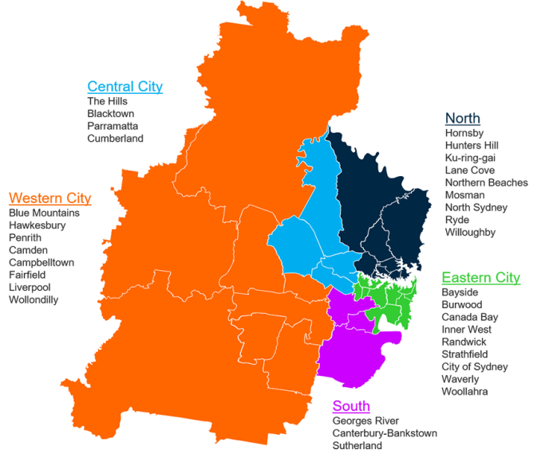
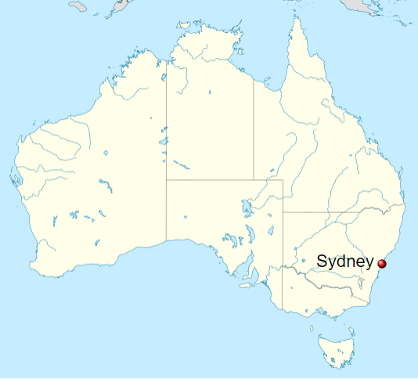
Greater Metropolitan Sydney
The Greater Metropolitan Sydney comprise of various Local Government Areas (LGAs), which we will refer to as Neighbourhoods/LGA interchangeably;
It is one of the most populous and vibrant area in the state of New South Wales and hosts LGAs like Sydney (known of Opera house and NYE fireworks of course!)
Different regions within this area has varied geographic and socio-economic landscape. From busy business district of Sydney to calm suburbs of The Hills Shire and picturesque Blue Mountains, there is something for everyone!
Image source: https://sport.nsw.gov.au/
Image source: Wikipedia

Slide 4
Data source
In order to explore various LGAs within the Sydney Region we have used following data sources:
Dwellings rental data by LGA/neighbourhood for September quarter 2019 (Source: www.facs.gov.au)
Dwellings sales data by LGA/neighbourhood for June quarter 2019 (Source: www.facs.gov.au)
Shape file of Sydney region (to plot geo maps and get co-ordinates of neighbourhoods)
Population data based on 2016 census (Source: http://stat.data.abs.gov.au/)
Crime data by LGA/neighbourhood for Year to date Sep 2019 (Source: https://www.bocsar.nsw.gov.au)
First we will clean the data by using Python to bring it in the format that can help us visualize the data as follows:
Rental cost per dwelling per neighbourhood
Median sale price per neighbourhood
Population per neighbourhood
Crime rate per neighbourhood
We will use a range of bar plots, scatter graphs, heat maps and Geo Spatial analysis to understand various factors that can impact a decision on the best place to live based on user preference
We will then use Four Square API to explore these neighbourhoods and through k-mean clustering analyse pros and cons of living in various neighbourhoods
All data is in AUD

Slide 5
Methodology
The analysis performed comprised of following sections with lot of foocus on rental since new migrants would probably rent as opposed to buying right away:
Property Rental analysis
Created Box plot to evaluate statistical range of rent per dwelling
Bar chart to view avg rental per suburb and total properties on rent at the end of Q2 2019
Scattered visualization of avg rent and total properties based on number of bedrooms for every neighbourhood
Heat map to evaluate distribution of rental by neighbourhood
Property Sales analysis
Bar graph to compare Median house price per neighbourhood
Understand Correlation between Avg rent and Median price
Choropleth map using Sydney’s shape file to visualize geospatially median prices and Number of dwellings sold
Population distribution analysis
Use of shape file to create Choropleth map of population distribution
Crime statistics analysis
Visualized relative number of crimes on Folium using Bubble map. Obtained co-ordinates from shape file and superimposed crime data over Folium Open street map
Four Square API venue exploration
- Finally explored all neighbourhoods using FourSquare API and the carried out k-mean clustering to create groups of neighbourhoods sharing similar amenities

Slide 6
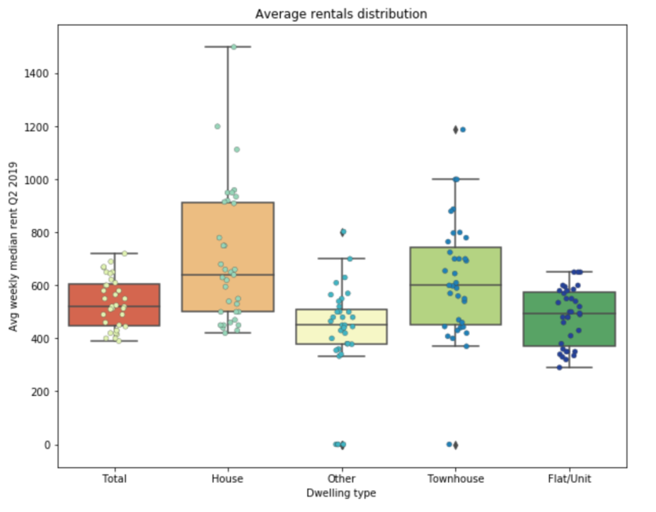
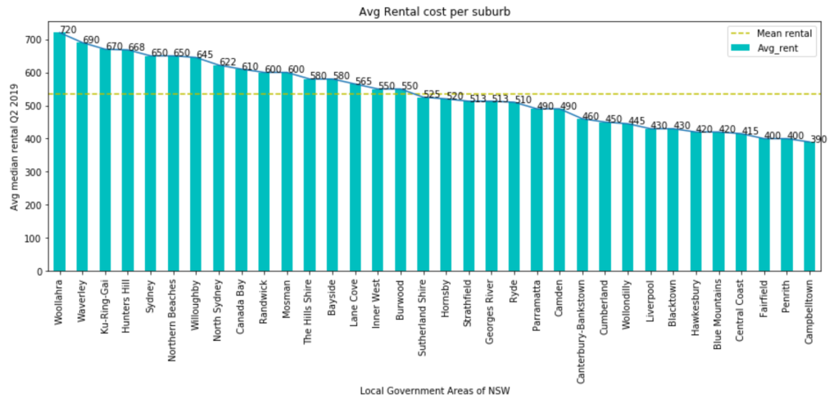
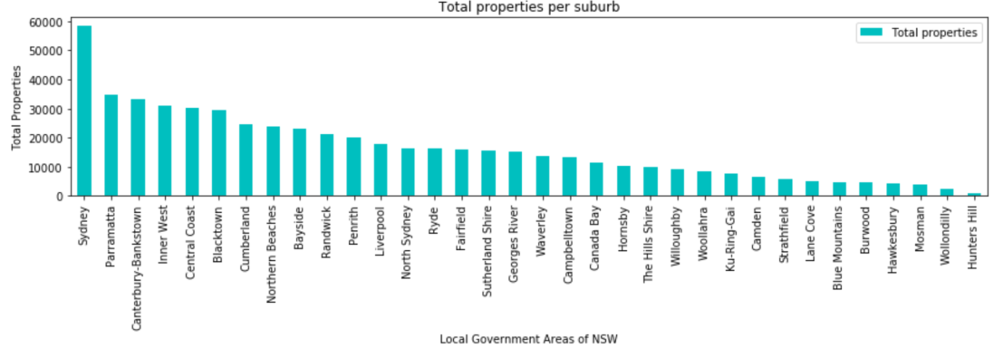
Results: Property Rental analysis
The Box plot on the right....
Bar plots above

Slide 7
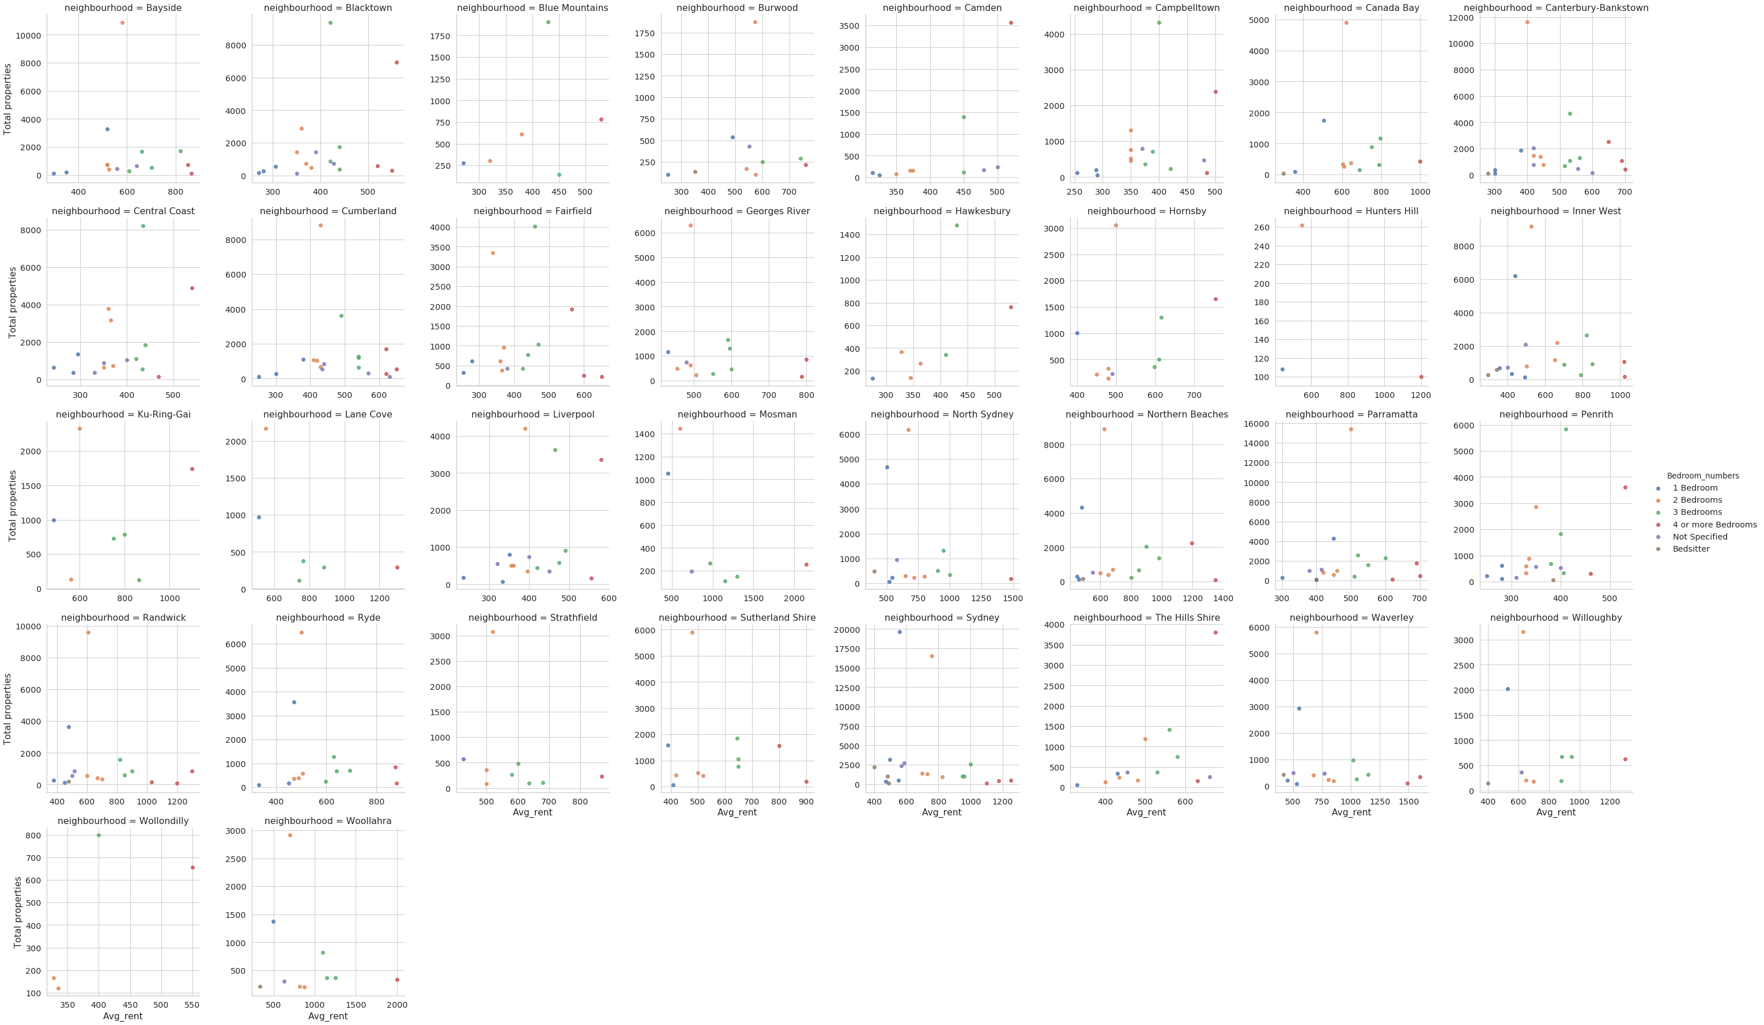
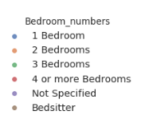
Results: Property Rental analysis (cont’d)
The scatter plots...

Slide 8
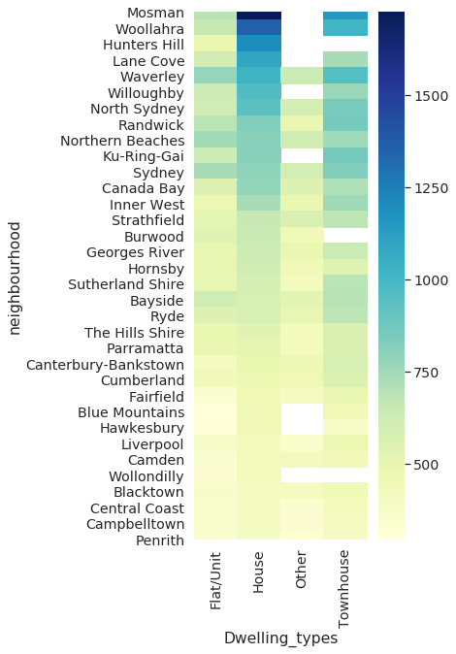
Results: Property Rental analysis (cont’d)
The scatter plots...

Slide 9
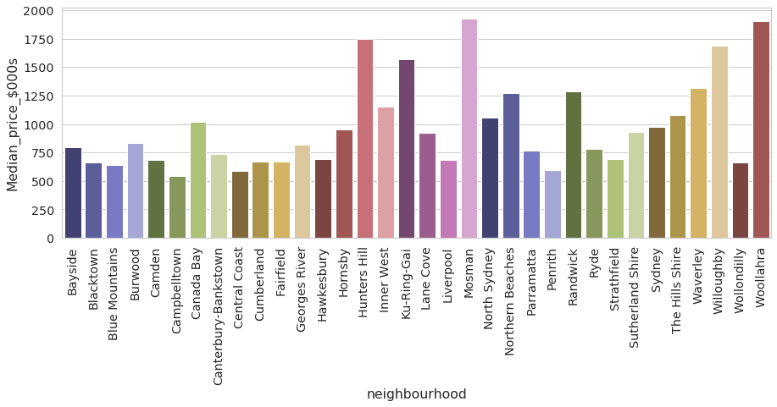
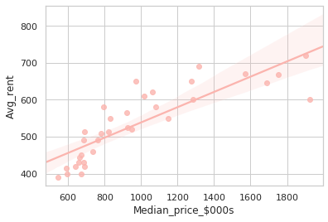
Results: Property Sale analysis
Scatter plot below
Bar plots above

Slide 10
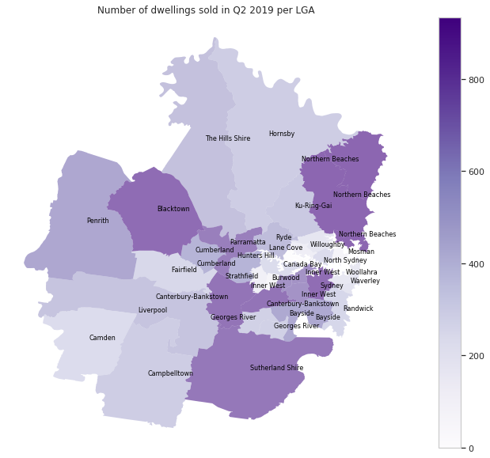
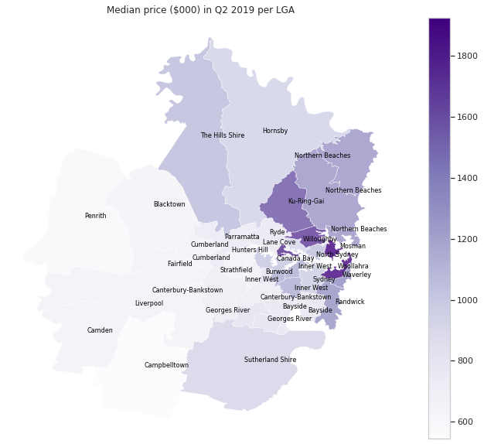
Results: Geospatial visualization

Slide 11
Caveats!
Scrapping data from various sources over the internet is one of the biggest challenge we face. There are number of factors to consider while reviewing the analysis:
Data was downloaded in various different formats and joined together which resulted in some loss of data e.g. certain neighbourhoods data being not available in one data set resulting in keeping only the valid values in new data frame;
The purpose of this analysis is educational only and cannot be used for any other purposes
The boundaries of LGAs keep on changing over various years e.g. merged more than one LGA to form a new one. In various data set (mostly that pertained to 2016 and beyond), a number of these changes happened, hence we had to take various averages and additions of data to make it comparable with other, more newer, data sets containing new LGAs.
Decision to live in a certain area depends on a number of factors and vary by individual requirements and the stage of life they are in. We have only used limited data as per previous slide to understand the compositions of different neighbourhoods.

